Slide 1
Basics II

Slide 2
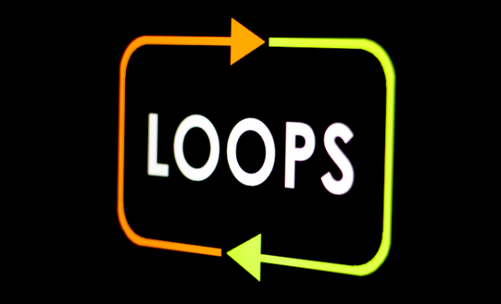

Slide 3
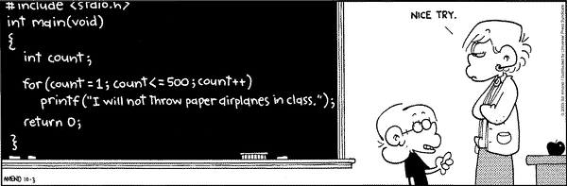

Slide 4

For loops
Why?
Execute code
multiple times
How?
When?
for( int i =0; i <10; i ++)
{
// code
}
Known number
of times

Slide 5
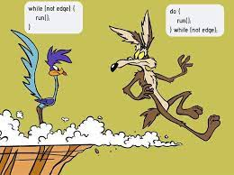
While(not edge){
run();
}
Do{
run();
}While(not edge);

Slide 6
While loops
Why?
Execute code
multiple times
How?
When?
While ( condition )
{
// code
}
Unknown number
of times

Slide 7
Do while loops
Why?
Execute code
multiple times
How?
When?
do{
// code
} While ( condition );
Unknown number
of times

Slide 8
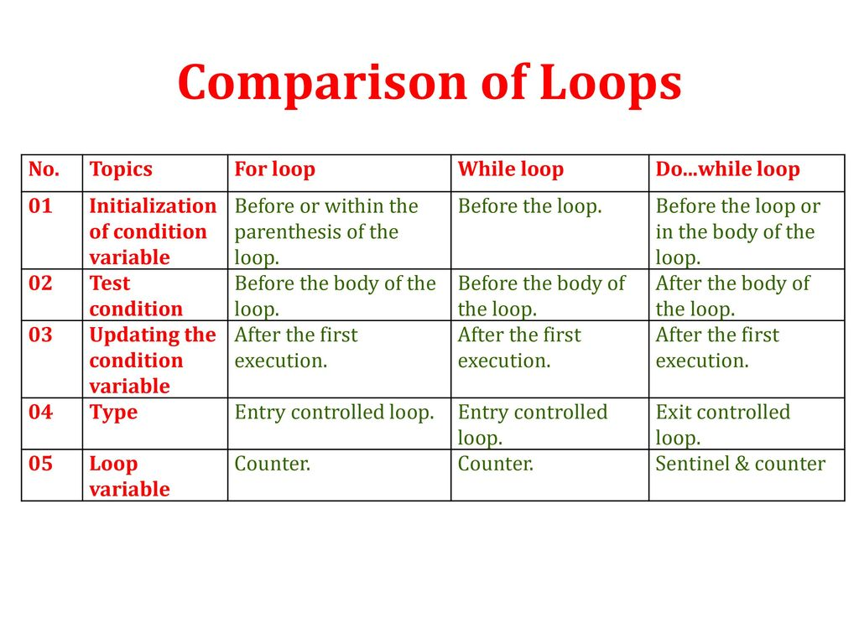
Notes:
Sentinel: default breaking point such as -1 or any other default value defined

Slide 9
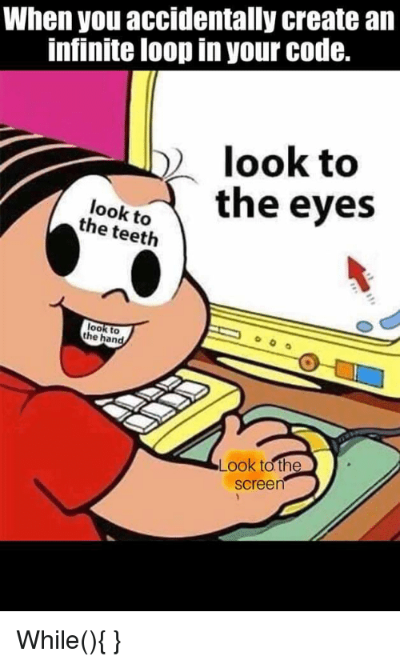

Slide 10


